Slide 1
FYP5: Object Detection, Tracking and Suspicious Activity Recognition for Maritime Surveillance using Thermal Vision

Slide 2
Weekly Tasks
Go through the identified topics of ISP
Literature review on Suspicious Activity Recognition
Prepare the flow diagram

Slide 3
ISP Design For Optical Systems
Contains three fundamental components
Electromechanical Structure
Control System
Auxiliary Equipment
Electromechanical Structure – Mass Stabilization Structure
Control System
Inner Stabilization Loop running inside an outer Tracking Loop
Stabilization Loop – Operates on LOS rate, Fundamental elements include Actuators (dc motors), Gyro (Rate gyro, rate-integrating gyro), Loop Compensator (P, PI, PID)
Track Loop – Operates on LOS angle, Tracker and Track loop should be designed together, possible Rate Aiding techniques to minimize the lags from tracker algorithm
Auxiliary Equipment – IMU,INS, Position Sensors

Slide 4
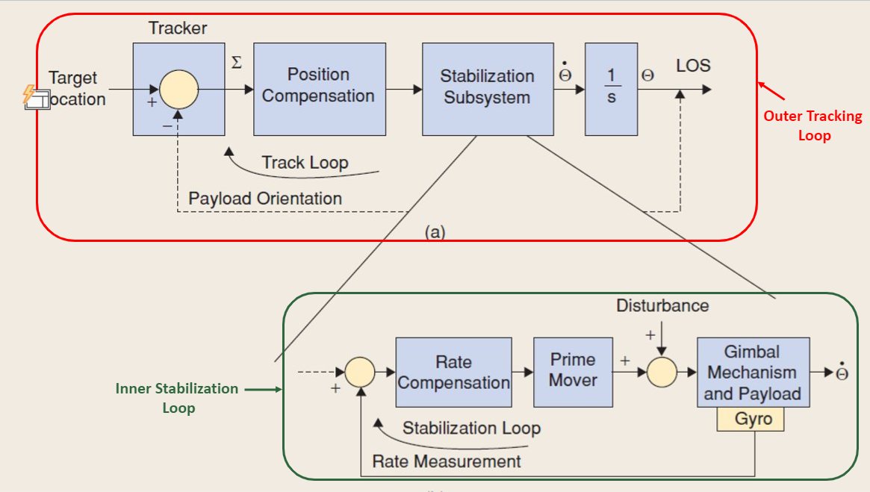

Slide 5
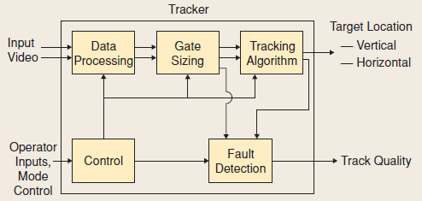
Target Tracking
Common Target Trackers
Contrast edge
Contrast centroid
Adaptive gate centroid (AGCT)
Correlation
Exceedance integration
Histogram projection
Extended Kalman

Slide 6
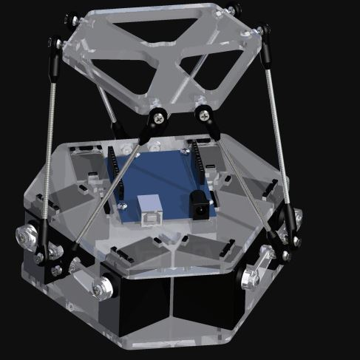
Proposed Model for the Stabilized Platform

Slide 7
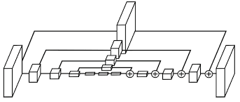
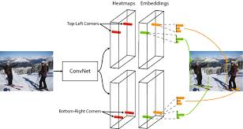
Object Detection Model - CenterNet
Base Network – Hourglass Network (ECCV 2016)
Originally used for human pose estimation
Repeated convolution and deconvolution with residual connections
Original Idea – CornerNet (ECCV 2018)
One stage detector
Detects 2 keypoints per object:
The top left corner of the bounding box
The bottom right corner of the bounding box
Matches the top and bottom corners using embedding vectors

Slide 8
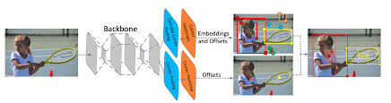
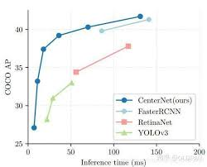
Object Detection Model - CenterNet
CenterNet (ICCV 2019)
Uses a 3rd keypoint – The center of the bounding box
Advantages:
One stage detector – faster than 2-stage detectors
No anchor boxes required – No handcrafting boxes and faster training

Slide 9
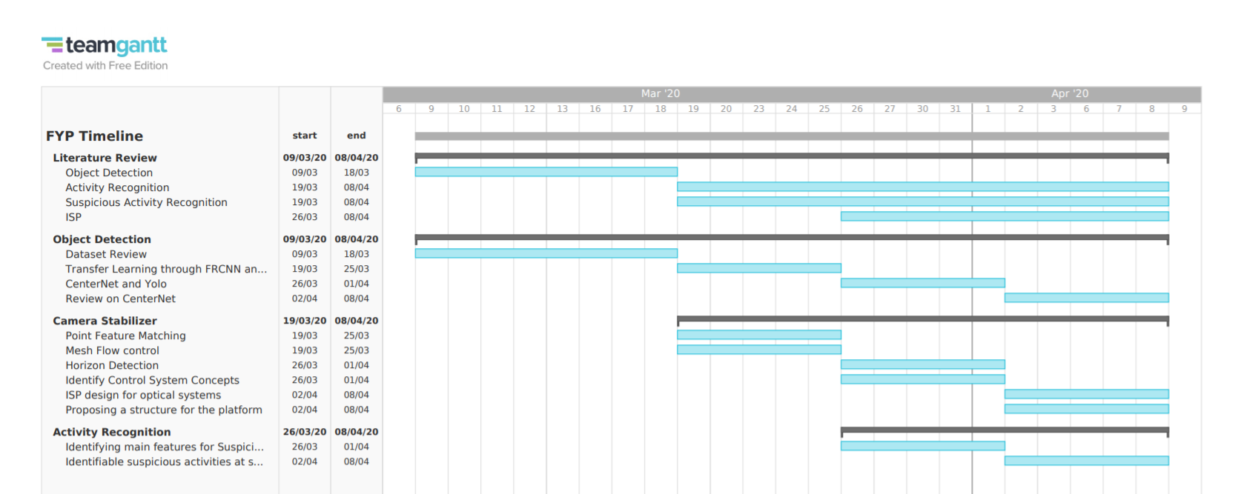

Slide 10

Tasks for next week
Try to implement a basic PID controller given in a paper on Matlab or python and see its outputs.
Get hands on experience in Matlab and Python Control System Modules.
Study more about stabilization loops and tracking loops.
Start learning Adams/SolidWorks for simulations.

